Slide 1
ENSE 470: Milestone 1
Team Dancing to Zebras
Tristan Heisler, Demitri Kourles and Zuoxiu Xing
January 18th, 2018

Slide 2
Team Introduction
Our names are Tristan Heisler, Demitri Kourles and Zuoxiu Xing.
Together, we are Team Dancing to Zebras.

Slide 3
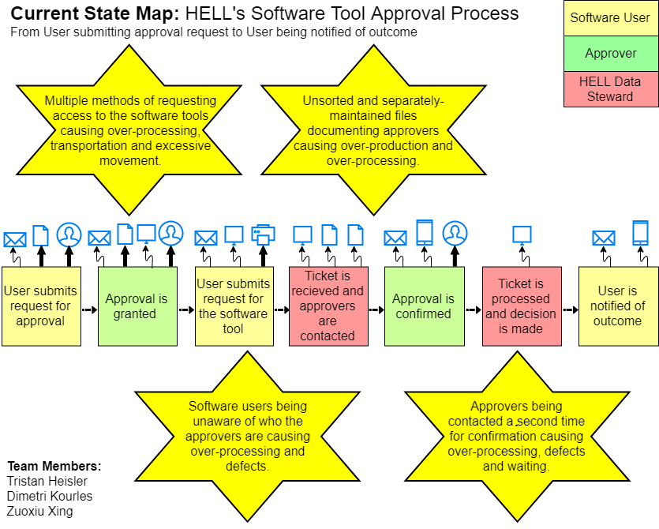

Slide 4
Values of the Current VSM
By identifying unnecessary processes and interactions with this system, wastes can hopefully be eliminated in the future.
The identified Kaizen Bursts will allow solutions to target specific aspects of the system.
Identifying key issues within the existing software will aid one in considering the overall project deliverables when proposing or implementing solutions.

Slide 5
Group Reflection
How did you feel about this milestone? What did you like about it? What did you dislike?
We liked that we were given time to properly familiarize ourselves with the process and identify problems rather than immediately being expected to implement a solution. No particular dislikes were brought forward by group members.
What did you learn about yourself as you collaborated and worked through this milestone?
It was reinforced that different people bring unique and valuable perspectives to a group. While some issues in the process were straightforward, other potential issues were only discovered by particular group members.
How will you use what you have learned going forward?
In this project, we will be able to suggest and implement a better solution for HELL based on our identified problems. In our future careers, we will spend more time identifying problems before suggesting solutions.
What “stuff & things” related to this milestone would you want help with?
It would be useful to know if specific images should be utilized for the various types of processes. It may also be useful to suggest software for creating the VSM.

Slide 6
Questions?

